Slide 1



Enterprise equipment scheduling for Charles River Laboratories
Proposal summary · 2026
Craig Davison
Senior Account Executive, Calira
craig@calira.co
© 2026 calira.co All rights reserved
Notes:
Timing: 0:00–0:30. Thank the panel; confirm attendees have read the written proposal; we will not walk through it line by line. Purpose today: the things that matter most and where Calira is different. Introduce anyone else on the call (Chris Mills, Head of Product / project manager; Morsal Amini, implementation lead).

Slide 2
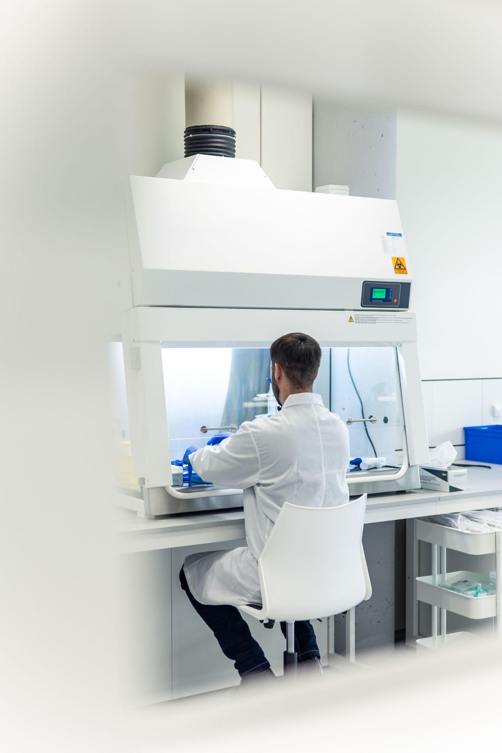

AGENDA
What we will cover in the next 25 minutes
Structured around the six areas you asked us to focus on
1
Calira in brief
3 min
Who we are, scale, and our existing work inside CRL
2
Your objectives and challenges
4 min
What we heard, and how we read your requirements
3
Proposed solution
6 min
Key capabilities, scalability, and – candidly – the constraints
4
Differentiators and value drivers
4 min
Why Calira, and where the value comes from
5
Implementation approach
4 min
Lead site in 8 weeks, then rollout waves; team and KPIs
6
Commercial, licensing and cost structure
3 min
Licence model, services, terms and exceptions
Proposal summary for Charles River Laboratories
1
Notes:
Timing: 0:30–1:00. Six sections mirror the panel's brief. ~24 minutes of content leaves time for questions; invite interruptions.

Slide 3








ABOUT CALIRA
Built for R&D at scale – and already live inside CRL
The world's leading R&D equipment scheduling platform · founded 2019 · rebranded from Clustermarket in 2025 · London, Sofia, Boston
11M+
84,000+
66,000+
1,800+
50+
Already a CRL partner
bookings
active users
instruments
laboratories
countries
Live today in CRL's Chemistry department, Edinburgh, under an existing contract
Day-to-day equipment scheduling plus insight into asset utilisation, revenue per asset and analysis success rates
16 enterprise implementations of 500+ users as primary implementer; multi-site rollouts at Novo Nordisk, Moderna and Eli Lilly
Year-on-year growth of 81% (2024–25) and 34% (2025–26); 17 staff, 9 in product and engineering
Trusted by leading life-science organisations
Proposal summary for Charles River Laboratories
2
Notes:
Timing: 1:00–4:00. Lead with scale (11M bookings, 84k users) then land the key point: we are not a new vendor to CRL – Edinburgh Chemistry runs on Calira today and that reference is available. Mention the team: Customer Success in London, engineering in Sofia, sales in Boston; Digital Craftsmen hold ISO 27001 and CE+ and give 24/7 infrastructure cover. Growth figures show a healthy, growing company without disclosing revenue.

Slide 4
YOUR OBJECTIVES
What we heard: one enterprise scheduling method, with evidence you can act on
The scheduling challenges behind it
Your strategic objective
A unified, enterprise-scale platform that accelerates study delivery, optimises resource allocation and enables data-driven decisions – replacing a patchwork of local applications and shared spreadsheets with a single source of truth for planning, scheduling and execution.
1
Local and inconsistent
Scheduling is run site by site, in different tools and spreadsheets, with no common method.
2
Capacity you cannot see
Instrument capacity is invisible at enterprise level, so it cannot be planned or shared across sites.
Your requirements span eight areas
Time lost to coordination
3
Core scheduling · User experience · Governance · Integration · Global planning · Functional scheduling · Tasking · Execute & adjust
Scientists and lab managers spend effort negotiating access manually; conflicts delay studies.
4
Capital decisions without evidence
Purchase, relocation and retirement decisions are taken without reliable utilisation data.
Proposal summary for Charles River Laboratories
3
Notes:
Timing: 4:00–6:00. Play back CRL's objective in their words (from the RFP and our SOW background). The four challenges are the costs the SOW is designed to remove. Then set up the next slide: your requirement set is broad – from study-level scheduling to daily tasking – and we want to be precise about where Calira fits.

Slide 5
SOLUTION
Provantis runs the study; Calira runs the resources
Our honest position on scope – stated openly in the C1 questionnaire and reflected in the SOW
Study layer – Provantis, RPM, Apollo (CRL systems)
What Calira does not do today
Study award to finalisation · milestones, endpoints and deliverables · protocols and study types · staffing and animal resources · portfolio and programme planning
Model studies or milestones, or generate schedules from them
Schedule people or animals, or integrate HR, leave and skills data
Automatically re-plan, cascade dependencies or optimise by weighting factors
Gantt or study-calendar views; scheduled exports (CSV and API exports are supported)
A complete 21 CFR Part 11 audit trail across all scheduling actions (on our roadmap) or GxP validation deliverables
REST API · discovery-gated integration
Resource layer – Calira
Equipment, rooms and specialised resources scheduled to the minute, across sites and time zones (UTC-stored)
Booking rules, approvals, access groups and training-based access; recurring, group and multi-step workflow bookings
Actual usage captured at the instrument (LabTrack) and at the point of use (Custom Forms)
Utilisation, capacity and adoption data for every lab, department and site – exportable and API-accessible
Why this is the right split. It keeps the study system of record where it already is, avoids duplicating Provantis, lowers total cost of ownership and lets CRL adopt the resource layer in weeks rather than years.
Proposal summary for Charles River Laboratories
4
Notes:
Timing: 6:00–8:00. This is the most important slide. Be direct: Calira is not a study-management or workforce-scheduling system and we did not pretend otherwise in the questionnaire. Calira is the resource layer – equipment, rooms, workflows, actual usage, utilisation truth – and it connects to the study layer through a REST API. The value of the split: no duplication of Provantis, faster adoption, lower TCO. Mention the audit-trail roadmap briefly if asked; do not over-promise dates.

Slide 6
SOLUTION
Requirement fit: strongest where scheduling meets the bench
Tally of our 73 responses in Exhibit C1 (Solution Requirements Questionnaire)
Strong fit
Functional scheduling, tasking, execute & adjust, governance and user experience: the day-to-day of booking, using and reporting on shared resources.
Partial fit
Global planning: multi-site utilisation and capacity views are native; study, portfolio and scenario modelling are not.
By design, not a gap
Study-lifecycle scheduling stays in Provantis. Calira supplies the resource availability and actuals it needs.
Proposal summary for Charles River Laboratories
5
Notes:
Timing: 8:00–9:30. Overall 19 fully / 32 partially / 22 not met. Read the chart top to bottom: the 'does not meet' weight sits almost entirely in the study-lifecycle and global-planning areas, which is exactly the layer we propose stays in Provantis. Where the requirement is about booking, using, governing and reporting on shared resources, fit is strong. Offer a walk-through of any specific requirement in Q&A.

Slide 7

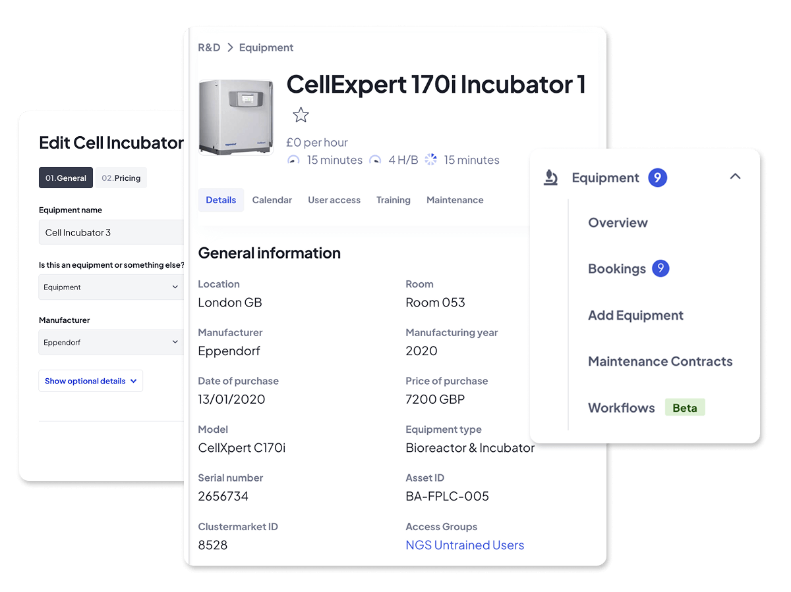



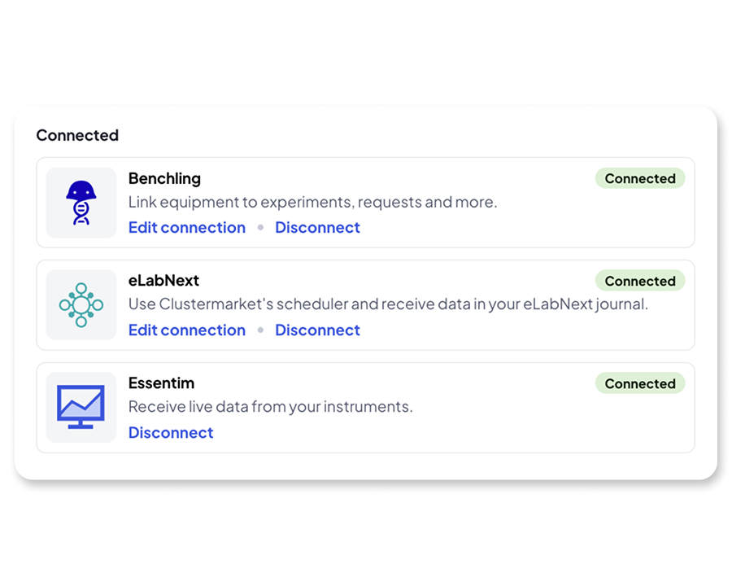
SOLUTION
What CRL gets on day one
Configured, not custom-built – every capability below is standard product
Book and schedule
Equipment estate
Access and governance
Drag-and-drop calendar, 15-minute slots
Rules, quotas, cut-offs and approvals
Recurring, group and workflow bookings
Bulk registration, metadata, documents, SOPs
Rooms, parent/child equipment, locations
Maintenance, service contracts and alerts
SAML 2.0 SSO, MFA, joiner/mover/leaver
Seven roles plus access groups
Training-based access; per-lab time zones
Capture at the point of use
Report and extract
Connect
Custom Forms: results, sample IDs, files
LabTrack: actual usage and instrument locking
Live instrument status via the OEM Gateway
Reports module, saved filters, CSV export
Read/write REST API (OAuth2)
Metabase dashboards at no extra cost; optional AI assistant
Outlook / Exchange calendar sync
Benchling, eLabNext, RSpace; Essentim sensors
Provantis, Maximo, Sapio via discovery-gated adapters
Proposal summary for Charles River Laboratories
6
Notes:
Timing: 9:30–11:00. Do not read the tiles. Pick two stories: (1) a scientist books a confocal from Outlook or a QR code on the instrument, LabTrack records the real session, the Custom Form captures the result – all with no extra system to log into; (2) a lab manager sees utilisation across every site and exports it or queries it via API. Everything shown is standard product; the deployment is configuration, which is why implementation is fast and unpriced.

Slide 8
SOLUTION
Built to run enterprise-wide: scale, resilience and security
Scale
Resilience
Security
Multi-tenant SaaS on AWS (Dublin), containerised on Kubernetes
Horizontal and vertical auto-scaling – no licence impact when scaling
1,800+ labs in 50+ countries; per-lab time zones with UTC storage
Named-user licensing with unlimited instruments and sites
Responsive web app on desktop, tablet and mobile; no client install (LabTrack optional, Windows)
Components across multiple availability zones; RDS with standby and automated failover
Continuous point-in-time recovery (96 h), daily and weekly backups, encrypted and off-site
Availability target 99.8% per month; SLA with service credits; status.calira.co
24/7 monitoring (Grafana, Prometheus, Sentry, Coralogix, UptimeRobot); P1 response 30 min
Zero-downtime CI/CD releases; DR restore within 24 h
Cloudflare WAF, DDoS protection and rate limiting at the edge; database reachable only inside the private network
TLS 1.2+ in transit, AES-256 at rest; secrets in KMS
SSO (SAML 2.0), MFA, least-privilege RBAC, quarterly access reviews
Hosting partner ISO 27001 and Cyber Essentials Plus; annual penetration test
GDPR-compliant, EEA-hosted; AI features can be disabled at account level
Hosting partner: ISO 27001 & Cyber Essentials Plus
Annual penetration test · quarterly vulnerability scans
GDPR · EEA-hosted · DPA with SCCs
Public status page: status.calira.co
Proposal summary for Charles River Laboratories
7
Notes:
Timing: 11:00–12:00. Keep this brief; the architecture questionnaire covers it in depth. Three messages: it scales without licence penalties; it is resilient with an SLA and public status page; it is secured at the edge, in transit and at rest, with ISO 27001 hosting and CE+ – and the AI components are optional and switchable.

Slide 9

SOLUTION
Integrations: two standard, three discovery-gated
You see each Discovery Report – and decide – before any integration build is priced
Why we are confident on the three new systems
Single Sign-On (IdP)
Standard · configured in Phase 2
One adapter framework for every integration: OAuth2/API-key auth, signed webhooks, background processing, central monitoring – a new vendor is a new adapter, not new infrastructure
Provantis: our Head of Product spent 5+ years at Instem and knows the module architecture; Instem's new REST API and hosted SaaS delivery fit our pattern
Maximo: enterprise-asset data mapping already scoped for Blue Mountain RAM; Maximo Manage REST API is mature and documented
Sapio: live ELN integrations with Benchling and eLabNext follow the same REST-plus-webhook shape
Each discovery ends in a report with data mapping, auth approach, dependencies and a build estimate – accepted by CRL before any build SOW
Outlook / Exchange
Standard · configured in Phase 2
Sapio Sciences ELN
Calira
Discovery in SOW · build by separate SOW
Provantis (Instem)
Discovery in SOW · build by separate SOW
IBM Maximo
Discovery in SOW · build by separate SOW
Proposal summary for Charles River Laboratories
8
Notes:
Timing: 12:00–13:30. Two integrations are standard and delivered in Phase 2 by configuration. For Provantis, Maximo and Sapio we said openly that we have no production integration yet; the SOW funds a technical discovery for all three, in parallel with the rollout, and CRL accepts each report before any build is priced. Emphasise the Instem experience for Provantis and the transferable EAM work for Maximo.

Slide 10

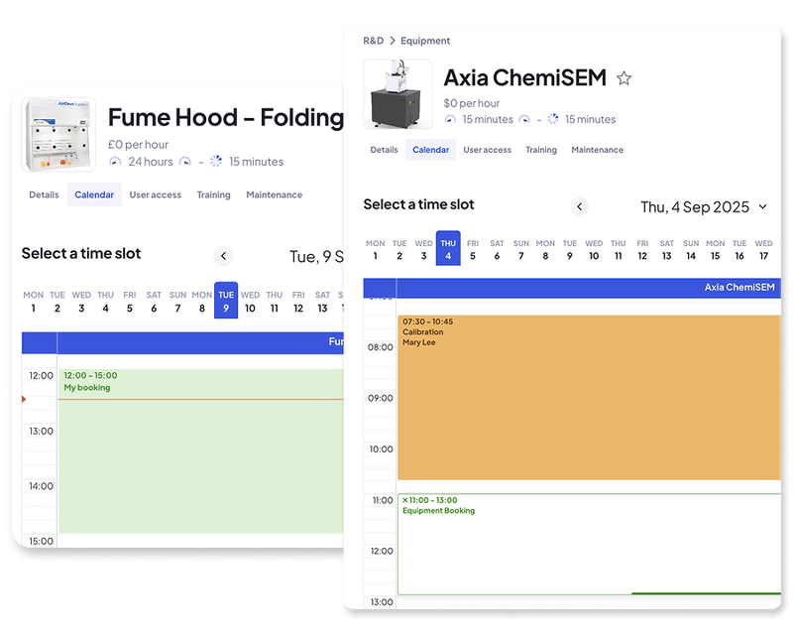
DIFFERENTIATORS
Why Calira for CRL
Six things we would ask you to weigh against any alternative
Proven inside CRL
Speed to value
Adoption by design
Live in Edinburgh Chemistry under an existing contract – a reference you can call today, and a configuration baseline we can reuse.
Lead site live in 8 weeks; each further site faster against the baseline. Standard implementation carries no services fee.
Researchers productive after 20–30 minutes of training; mobile and QR-code booking; contractual adoption KPIs.
Actuals, not assumptions
AI-native, optional
A partner, not a ticket queue
LabTrack records real instrument sessions and locks equipment to bookings, so utilisation is measured, not guessed.
Natural-language querying and anomaly detection over usage data – switchable off at account level if CRL prefers.
Named Solutions Manager through go-live, named Customer Success Manager after it, product leadership in the room.
Proposal summary for Charles River Laboratories
9
Notes:
Timing: 13:30–15:30. The first tile is the one competitors cannot claim. Speed and adoption are backed by numbers in the SOW (KPIs). Actuals: LabTrack usage-logging and blocking modes. AI is a differentiator but reassure on control. Close on the partnership model – the people on this call are the people who deliver.

Slide 11
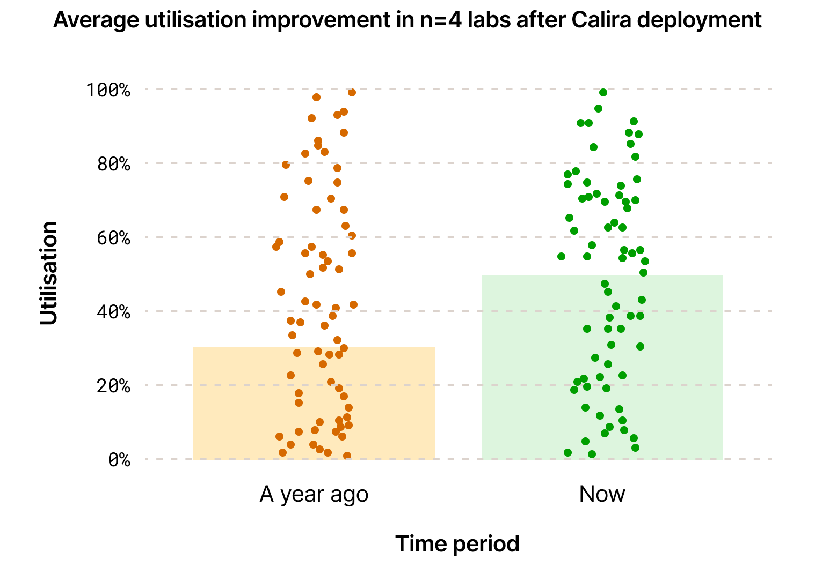
VALUE DRIVERS
The value case: utilisation, time and capital
35%
Fewer conflicts, less coordination
One live calendar per resource with rules and approvals removes double-booking and the negotiation around it.
average utilisation of R&D lab equipment – mostly lost to short, unmanaged stoppages (McKinsey, 2021)
Higher utilisation, deferred capital
Visibility plus measured actuals raise use of existing instruments before new ones are bought.
Enterprise capacity you can plan
Utilisation and capacity rolled up across labs, departments and sites – shared, moved or retired on evidence.
A single source of truth
Bookings, actual usage, maintenance and point-of-use records in one auditable place, exportable and API-accessible.
Lower total cost of ownership
Configuration not customisation, no implementation fee, and best-of-breed integration rather than replacing Provantis.
Proposal summary for Charles River Laboratories
10
Notes:
Timing: 15:30–17:00. Anchor on the McKinsey 35% figure, then the observed utilisation improvement across four labs after deployment (chart from our standard deck). Translate into CRL's three costs from the SOW: coordination time, invisible capacity, capital decisions. Mention that the executive value report in Phase 4 quantifies this for CRL's own estate.

Slide 12
IMPLEMENTATION
Lead site live in 8 weeks, then rollout waves
Three concurrent workstreams under our four-phase enterprise onboarding methodology
Wk 1
Wk 2
Wk 3
Wk 4
Wk 5
Wk 6
Wk 7
Wk 8
Post go-live
A · Phase 1 Kick-off
Goals, workflows, integrations, equipment data, go-live date
A · Phase 2 Requirements & configuration
On-site workshop · admin training · equipment · SSO + Outlook
A · Phase 3 Implementation & adoption
3 end-user workshops · UAT (10 days) · adoption dashboard · go-live readiness approval
A · Phase 4 Hypercare & optimisation
CSM-led · value report · roadmaps
B · Standard integrations
SSO and Outlook / Exchange – configuration only
C · Technical discovery ×3
Provantis, Maximo and Sapio in parallel → three Discovery Reports for CRL acceptance
Rollout waves. Each further site is onboarded against the Lead Site's configuration baseline, workflow library and training curriculum: Phase 1 reduced to site-specific confirmation, Phases 2–3 in full (on-site workshop per qualifying site), Phase 4 once at enterprise level. Sites are sequenced so each wave learns from the last.
Proposal summary for Charles River Laboratories
11
Notes:
Timing: 17:00–19:00. Walk the bars left to right. Lead site in 8 weeks is our standard, and the 8 weeks mostly reflects customer availability. Discovery runs in parallel so nothing waits on integrations. Effort from Calira per site is roughly 2–3 days (Phase 1), 9–10 (Phase 2), 12 (Phase 3), 4 (Phase 4). Rollout waves are how CRL's multi-site estate is covered without repeating full effort each time. Reference the Novo Nordisk three-site rollout: each site live within 8 weeks, scope unchanged across sites.

Slide 13
IMPLEMENTATION
Your Calira team, and the adoption KPIs we sign up to
MA
Morsal Amini
KPI | Target | If missed
Workshop attendance | ≥ 80% of invited SMEs per site | Extra virtual workshop, no fee
Administrator coverage | 100% attend a training session | Extra admin session, no fee
Training coverage | 100% of named users trained | Go-live not sought until remedied
User activation | ≥ 75% accept invitation within 10 days | Adoption clinic + mitigation plan
Booking adoption | ≥ 50% of activated users book within 30 days | Support workshop + workflow review
Sustained adoption | ≥ 50% of users active monthly, 3 months | Further optimisation support
Discovery quality | Reports accepted without material rework | Revised and resubmitted, no fee
Senior Solutions Manager · implementation lead, Phases 1–3 and all waves
NB
Nathan Beynon
Customer Success Manager · Phase 4 hypercare, adoption and value reporting
CM
Chris Mills
Head of Product · project manager; 25 years in R&D software, formerly Instem
HT
Hristo Tenev
Integration Engineer · Provantis, Maximo and Sapio discovery and build
CD
Craig Davison
Senior Account Executive · commercial lead and escalation
From CRL: project owner, IT (SSO, integrations), lab managers and admins, early-adopter users. All Calira staff are full-time employees; no implementation partner.
Measured from the adoption dashboard and reported at each check-in; targets assume CRL releases users for training.
Proposal summary for Charles River Laboratories
12
Notes:
Timing: 19:00–20:30. Introduce the named team – the same people named in the SOW and RACI. The KPI table is contractual in the SOW; each miss has a stated remedy at no fee, which is unusual and worth pointing out. Close with what we need from CRL: a project owner with authority, IT for SSO, lab managers for workflows, and users released for training.

Slide 14
COMMERCIALS
Named users, unlimited instruments, no implementation fees
Headline figures from Exhibits D1A, D2a/b and the SOW – all list prices in USD
Licence
Services
Terms
Named-user annual subscription: $405 per user per year (list)
Unlimited instruments, rooms, sites and bookings
Volume tiers: 10% off from 501 users, 15% from 1,001, 20% from 1,501, 25% from 2,001 (applied per tier band)
Multi-year: 10% off for 3 years, 15% for 5 years
LabTrack real-time tracking optional: $140 per asset per year
Site or enterprise licence available – open to discussion
Core implementation, training, SSO and Outlook: $0 (100% discount on standard implementation services)
Technical discovery for Provantis, IBM Maximo and Sapio: $31,200 fixed (30 engineer days + project management)
Integration builds priced by separate SOW after CRL accepts each Discovery Report
Initial SOW capped at $40,000 not-to-exceed
On-site workshops: no fee; travel and accommodation at cost, pre-approved
Rate card locked for the term
Pricing locked for 3 years; two further 1-year extensions on the same terms, increases capped to an agreed index
Users added any time, pro-rata, co-terminating with the annual term; re-baseline up or down at each anniversary
Payment 60 days from invoice (90 available if helpful)
SLA: availability with service credits; 10% of monthly fees at risk; termination for persistent failure
Global, non-exclusive term licence covering CRL and affiliates
Proposal summary for Charles River Laboratories
13
Notes:
Timing: 20:30–22:00. Keep it simple: one licence line, no implementation fee, one fixed discovery fee, builds only after CRL sees the discovery reports. Tier discounts apply within bands (we said no to retroactive tier benefit for all users – be ready for the question). Multi-year and volume discounts stack. Site/enterprise licence is available but needs user and site numbers, which the RFP left open.

Slide 15
COMMERCIALS
Commercial principles: 26 of 30 agreed, four flagged openly
Exhibit C6 responses, which are contractually binding
Agreed
Where we said no, or qualified our answer
3-year price lock, two 1-year extensions, index-capped increases
Own resources for implementation and future services – no implementation partner
User-based licensing; global, non-exclusive term licence for CRL and affiliates
Ramp-up volumes, pro-rata additions, co-termination, annual re-baselining
60-day payment terms; rates locked for the term
99.5% uptime commitment, SLA credits, 10% of fees at risk, termination for persistent failure
Proactive CX metrics, innovation tracking and demonstrable Agile delivery
GxP compliance
Calira is not GxP-validated; validation deliverables (IQ/OQ/PQ, Part 11) are excluded from the SOW. CRL may validate the platform itself.
Retroactive tier pricing
Tier discounts apply to users within each band, not to all users once a band is reached.
Credits for inactive users
Annual named-user contracts; users can be removed at any date, but no monthly-activity credit.
Partial termination
Termination rights are in whole, not by service line or geography.
Proposal summary for Charles River Laboratories
14
Notes:
Timing: 22:00–23:00. Panels respect suppliers who flag exceptions before contracting. GxP is the one to handle carefully: Calira holds booking and asset data, not study data, so validation risk is low; the SOW excludes validation deliverables but CRL can validate the platform if its QA function requires it. The other three are commercial mechanics and we are open to discussing them in negotiation.

Slide 16
NEXT STEPS
From proposal to lead-site go-live
1
2
3
4
References and demo
Confirm scope
Contract and kick-off
Week 8
Reference calls with Novo Nordisk, Moderna, Eli Lilly and CRL Edinburgh; a hands-on demo against your workflows.
Lead site, user and equipment counts, wave sequence and the integration priorities for discovery.
MSA, SOW and DPA finalised; project owner nominated; go-live date set at the kick-off meeting.
Lead site live and accepted; three Discovery Reports delivered; expansion plan agreed.
Questions
We are happy to walk through any individual requirement response, the SOW, or the security and architecture questionnaires.
Proposal summary for Charles River Laboratories
15
Notes:
Timing: 23:00–24:00, then Q&A. Ask for the decision timeline and who the CRL project owner would be. Offer the CRL Edinburgh reference first – it is the fastest way for the panel to de-risk.

Slide 17
Thank you
Craig Davison · Senior Account Executive
craig@calira.co · +44 (0)75 4515 2687
Chris Mills · Head of Product · chris@calira.co
Clustermarket Ltd DBA Calira · 34 Lime Street, London EC3M 7AT
calira.co
© 2026 calira.co All rights reserved
Notes:
Leave contact details on screen during Q&A.

